Slide 1

MACHINE LEARNING
EMOTION CLASSIFICATION TROUGH AUDIO

Slide 2
PRESENTATION OUTLINE
Introduction
Problem Statement
Model Descriptions
Dataset 1: EmoDB
Dataset 2: RAVDNESS
Dataset 3: CREMA-D
Dataset 4: SAVEE
Results
Inference

Slide 3
INTRODUCTION
The task is to recognize emotions from speech, specifically classifying audio recordings into different emotional categories such as happiness, sadness, anger, and fear. This problem is challenging due to the variability in how emotions are expressed in speech, including differences in tone, pitch, and speaking style across individuals.
Additionally, some emotional categories may be underrepresented, making it difficult for models to learn accurate representations for all emotions.

Slide 4
MOTIVATION
Improved User Interaction: Emotion recognition enables systems to respond more empathetically, enhancing the experience in applications like virtual assistants, customer service, and smart devices.
Mental Health Support: Recognizing emotions in speech can help detect emotional distress or mental health issues, offering support through early intervention or targeted assistance.

Slide 5
SOLUTION
We aim to classify emotions in speech using machine learning models: Decision Tree, Random Forest, Naive Bayes, KNN, and SVM. The goal is to predict the emotional category of a speech sample using key audio features.
The dataset will be preprocessed by extracting audio features, normalizing them, and splitting into training and testing sets. Each model will be trained, and their performance will be compared using accuracy, precision, recall, and ROC curves to find the best model.

Slide 6
MODELS USED
DECISION TREE
RANDOM FOREST
NAIVE BAYES
Splits data into branches based on features to make predictions.
Simple and effective but prone to overfitting.
Combines multiple decision trees to improve accuracy and reduce overfitting. Robust and reliable.
A fast, probabilistic model based on Bayes’ theorem, ideal for tasks with independent features.

Slide 7
MODELS USED
KNN
SVM
Classifies data by finding the majority class among its nearest neighbors.
Simple but computationally heavy.
Separates classes by finding the best hyperplane.
Effective for high-dimensional data but computationally expensive.

Slide 8
DATASET 1: BENGALURU HOUSE PRICE DATA
EmoDB (Berlin Database of Emotional Speech) is a well-known dataset containing audio recordings of German actors expressing various emotions. It is widely used in speech emotion recognition research due to its high-quality recordings and clearly defined emotional categories.
Features
MFCC (Mel-Frequency Cepstral Coefficients): Extracts features representing the short-term power spectrum of sound, capturing the timbral texture of speech.
Chroma: Represents the 12 different pitch classes, capturing harmonic content and tonality in the audio signal.
MEL Spectrogram Frequency: A representation of the audio signal in terms of its frequency content, using the MEL scale to better match human hearing.

Slide 9
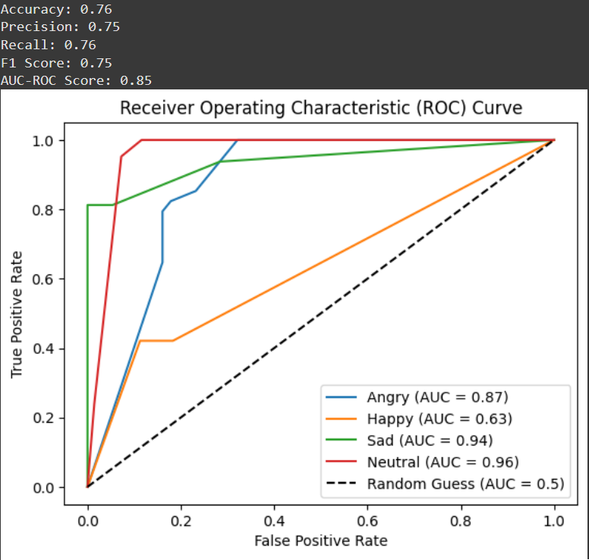
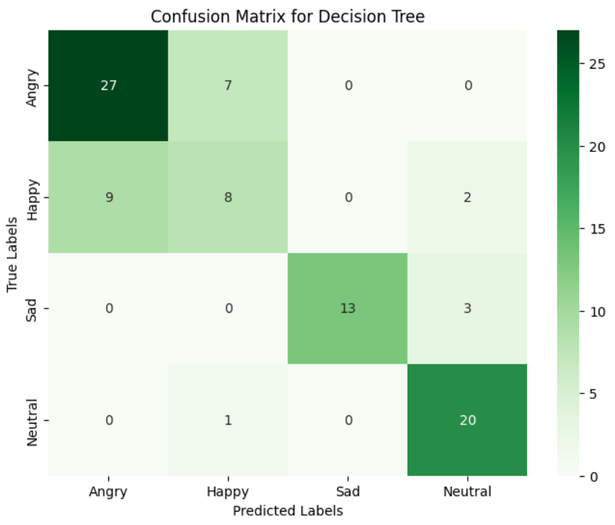
DECISION TREE

Slide 10
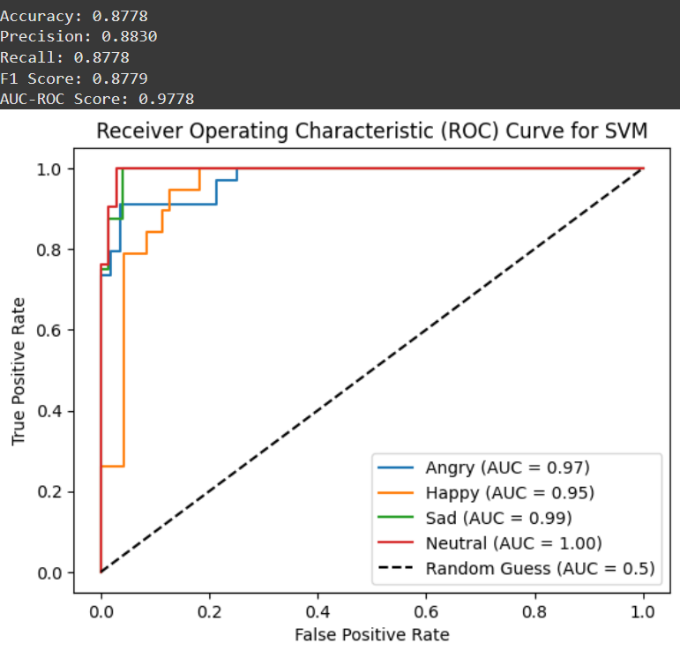
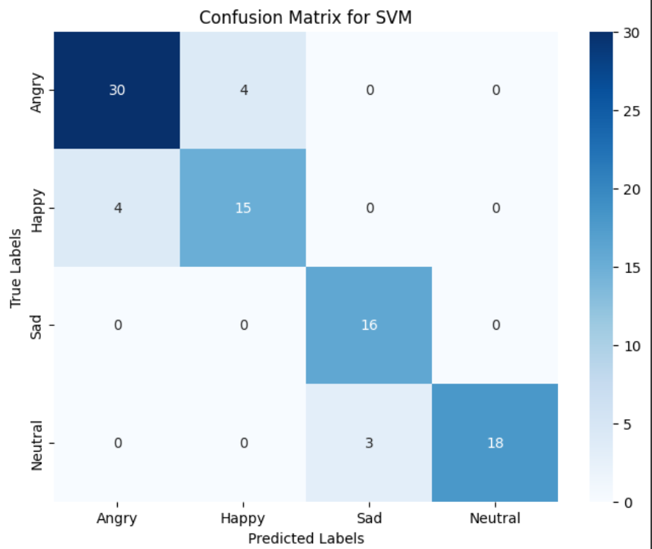
SUPPORT VECTOR MACHINES

Slide 11
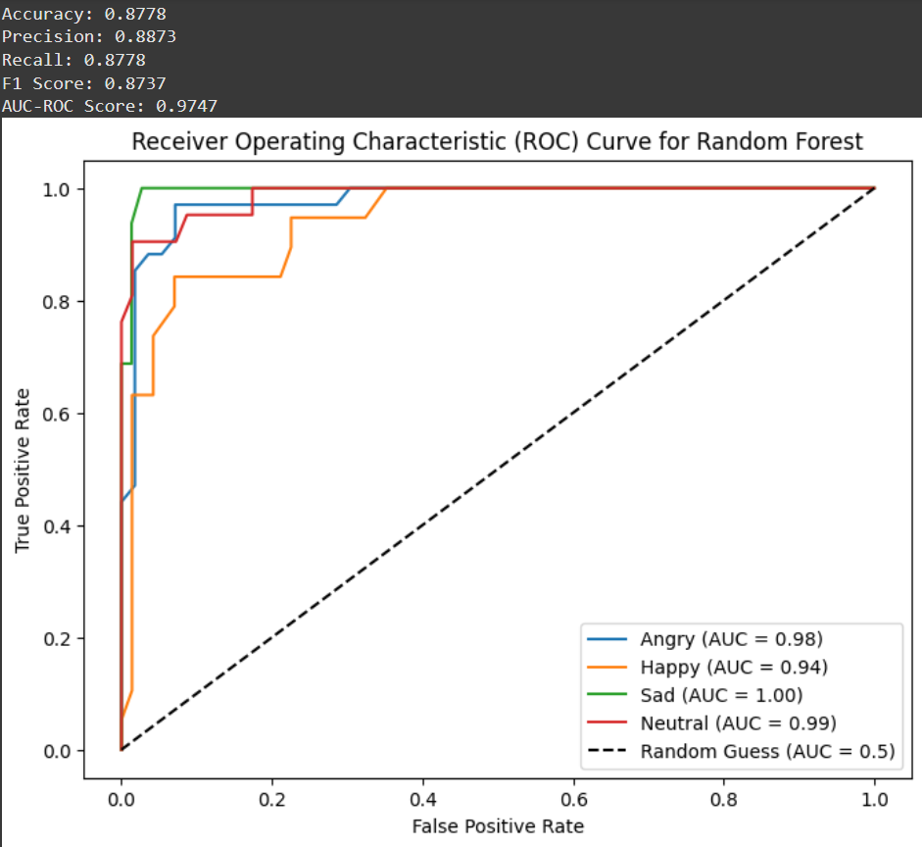
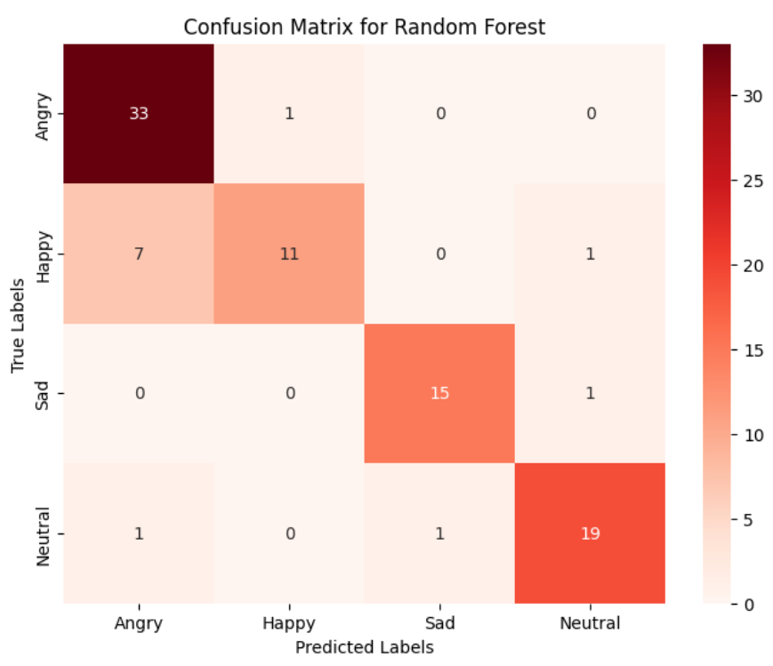
RANDOM FOREST

Slide 12
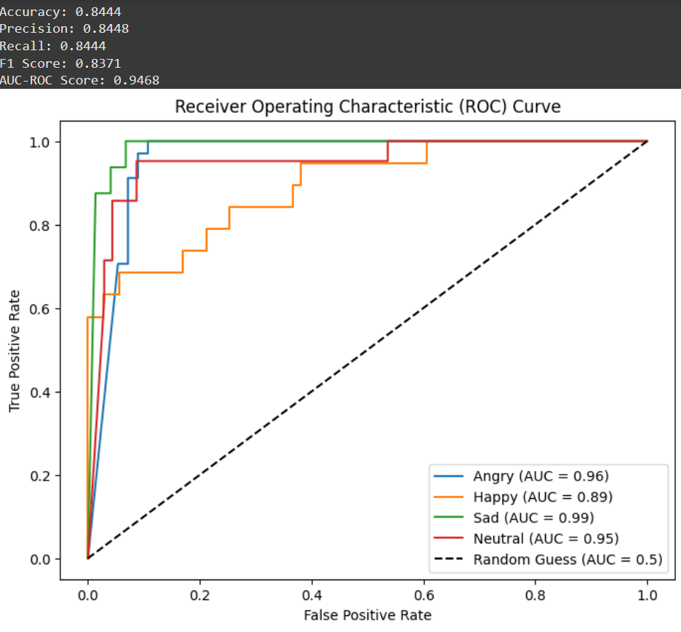
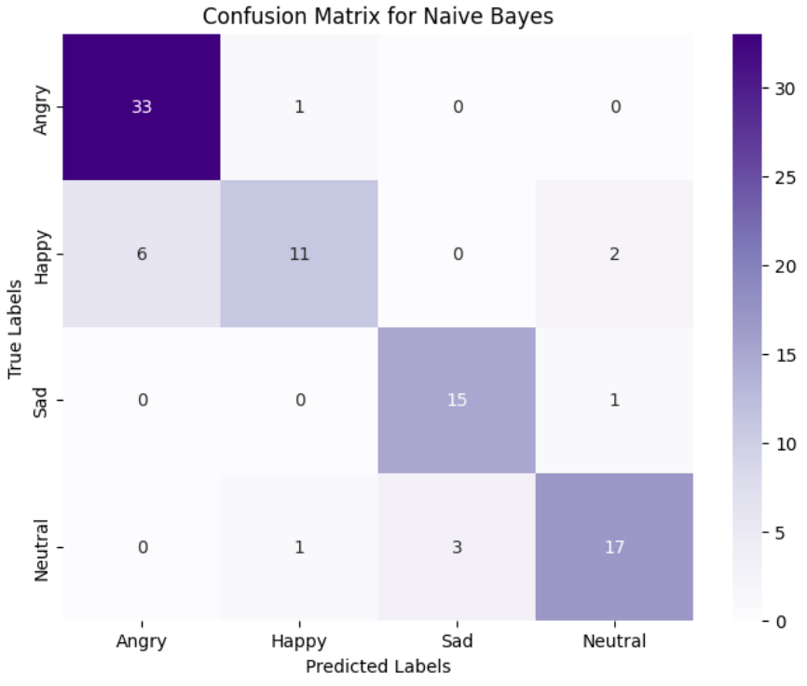
NAIVE BAYES

Slide 13
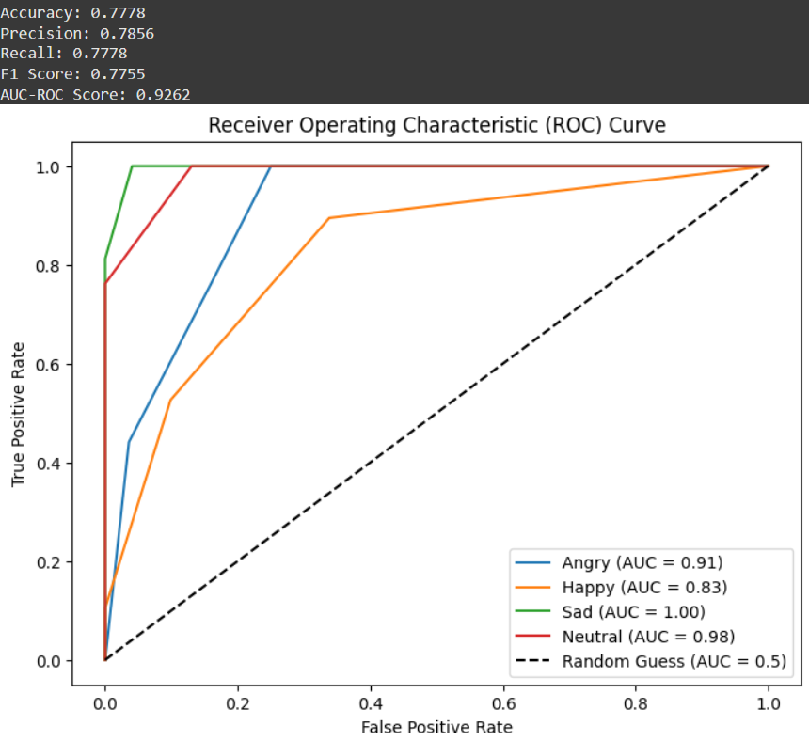
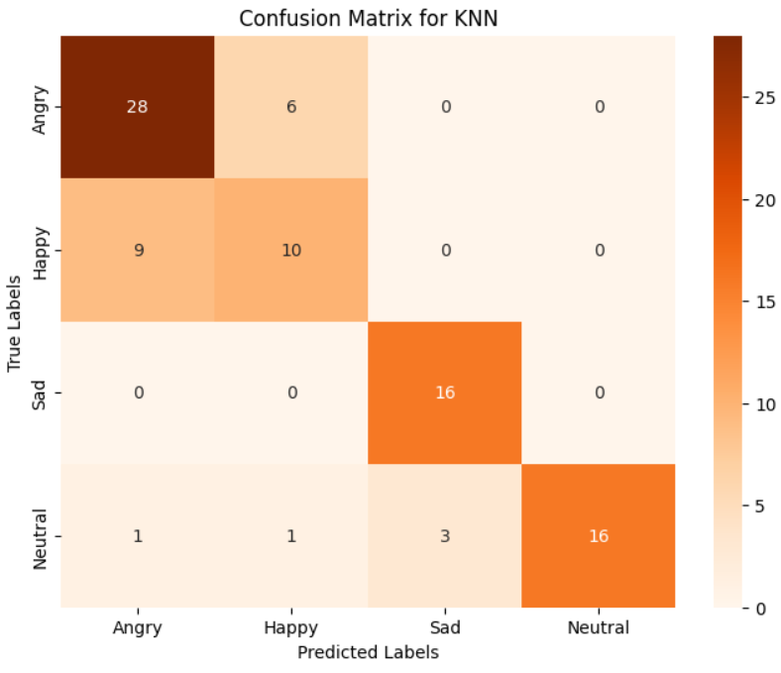
K NEAREST NEIGHBOURS

Slide 14
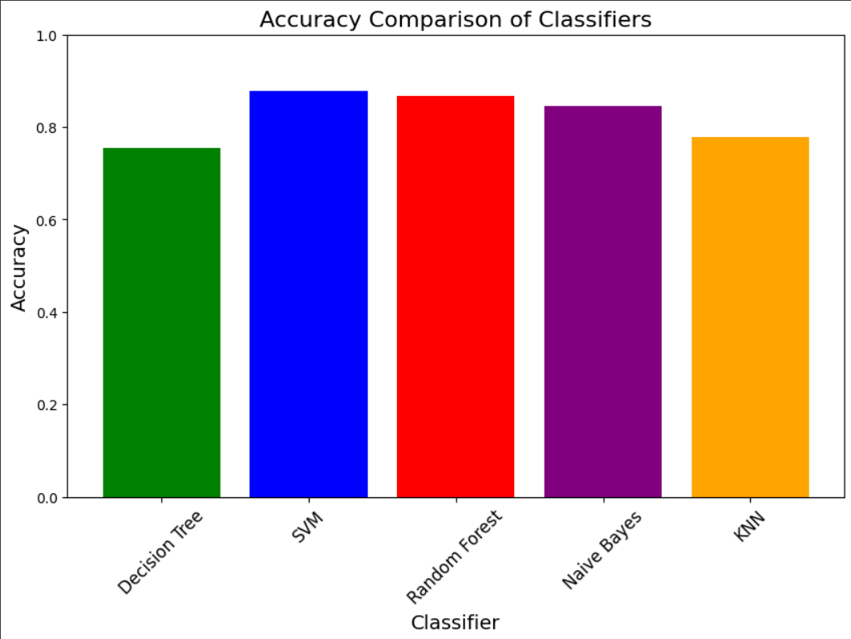
COMPARISON

Slide 15
REASON
Limited Dataset Size:
EmoDB contains only a limited number of recordings. SVM works effectively on smaller datasets, whereas models like k-NN often need more data to reach peak performance.
Feature Relationships:
The features in EmoDB are not independent. Models like Naive Bayes, which assume independence between features, struggle with correlated inputs.
SVM does not rely on independence assumptions, making it a better fit for this dataset.
Class Imbalance or Noise:
EmoDB could have imbalanced data across emotions. SVM’s C-parameter (soft margin) can effectively handle some misclassifications without heavily overfitting to noisy or minority classes.

Slide 16
DATASET 2: RAVDNESS
The RAVDESS (Ryerson Audio-Visual Database of Emotional Speech and Song) is a high-quality dataset designed for emotion recognition and affective computing research. It contains 1440 recordings from 24 professional actors (12 male, 12 female) expressing eight emotions: neutral, calm, happy, sad, angry, fearful, surprised, and disgusted, with most at two levels of intensity (normal and strong). The dataset includes speech and song in audio-only, visual-only, and audio-visual formats, making it ideal for multi-modal analysis. This resource is widely used for training and evaluating machine learning models in tasks like emotion classification and human-computer interaction.
Features
MFCC (Mel-Frequency Cepstral Coefficients): Extracts features representing the short-term power spectrum of sound, capturing the timbral texture of speech.
Chroma: Represents the 12 different pitch classes, capturing harmonic content and tonality in the audio signal.
MEL Spectrogram Frequency: A representation of the audio signal in terms of its frequency content, using the MEL scale to better match human hearing.
Contrast: Captures the spectral contrast between peaks and valleys in the sound spectrum, helping to differentiate between emotions.
Tonnetz: Describes harmonic relations in music, representing features like pitch and tempo, which can also reflect emotional states in speech.

Slide 17
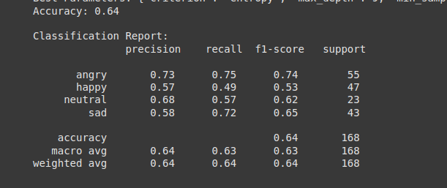
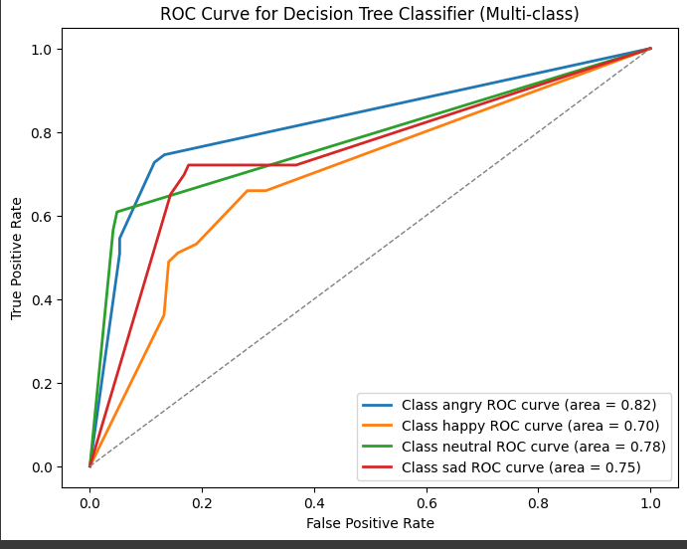
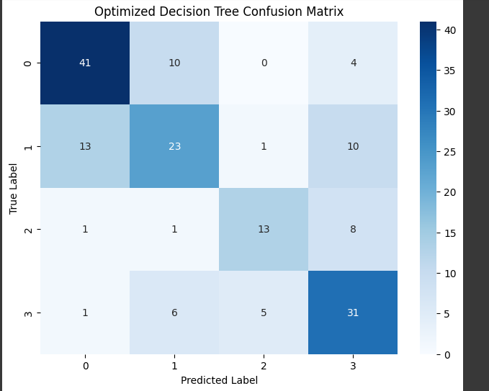

Slide 18
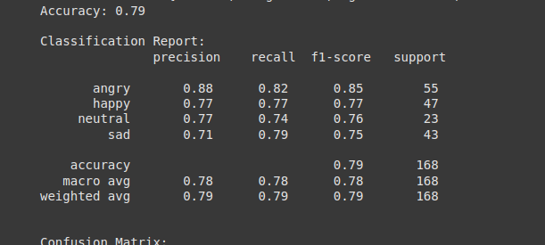
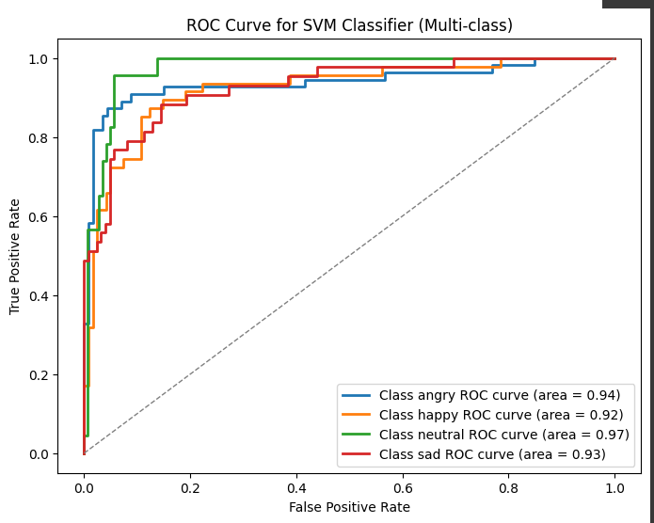
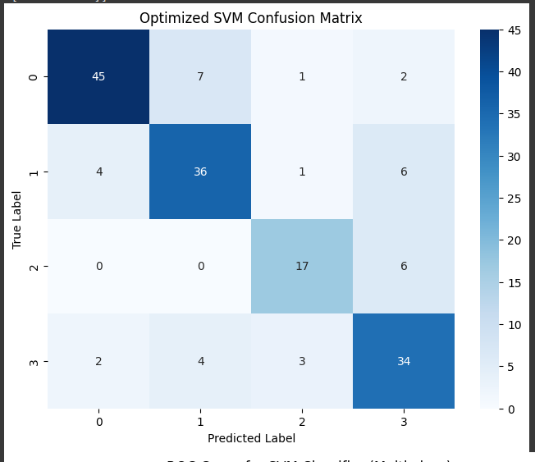

Slide 19
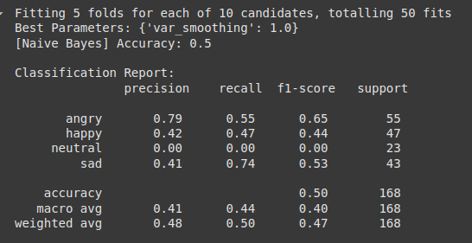
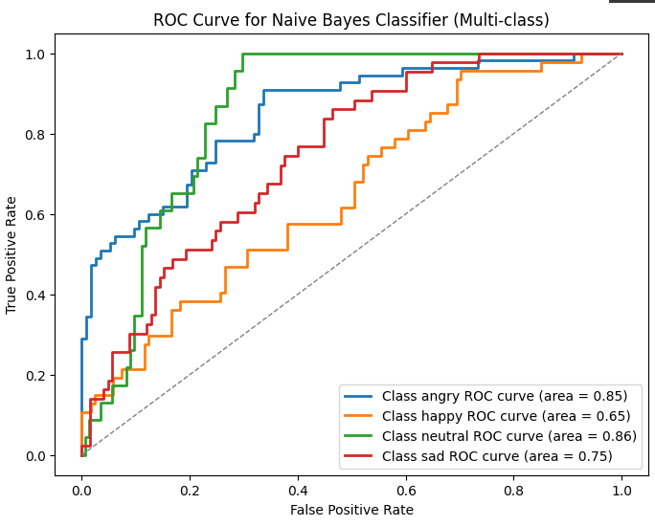
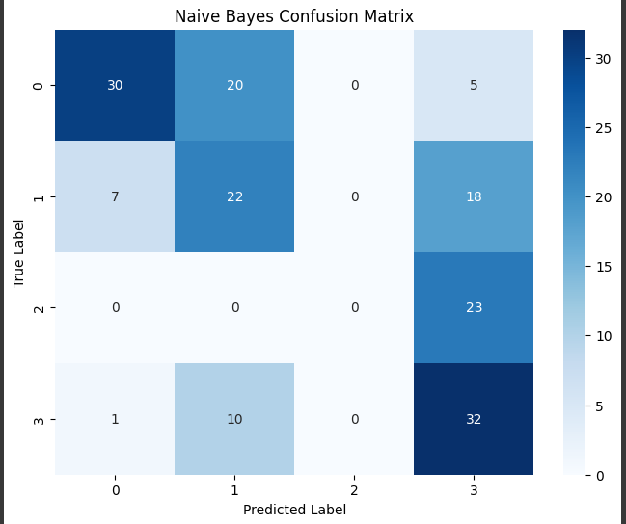

Slide 20
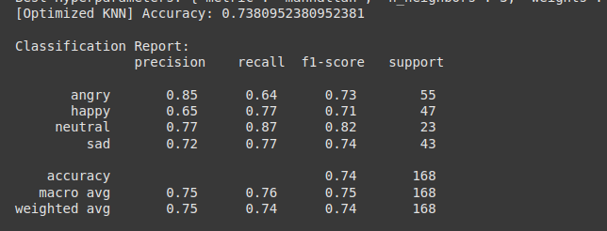
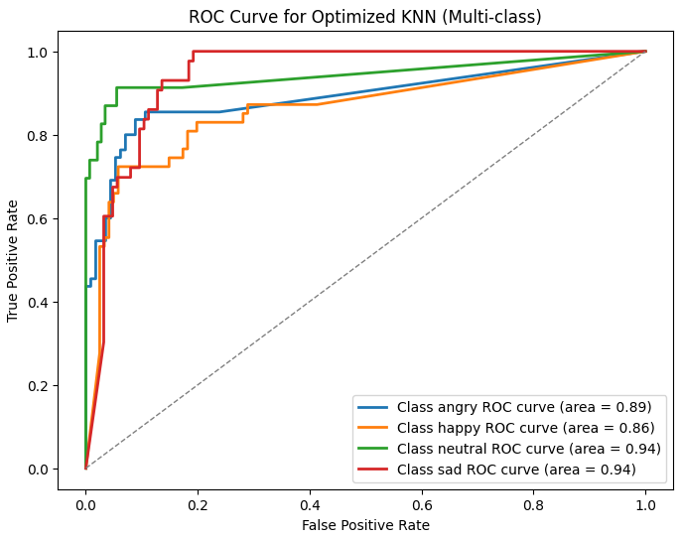
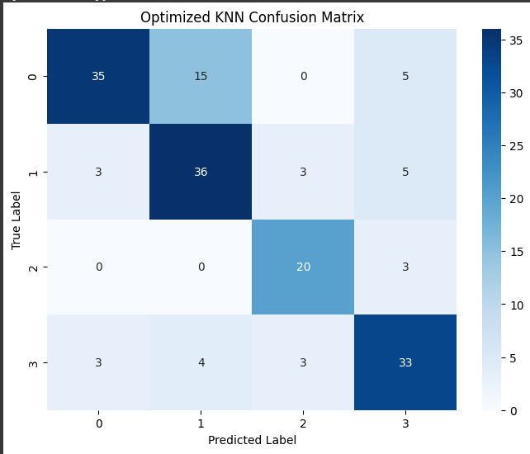

Slide 21
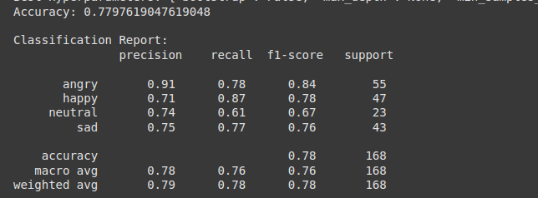
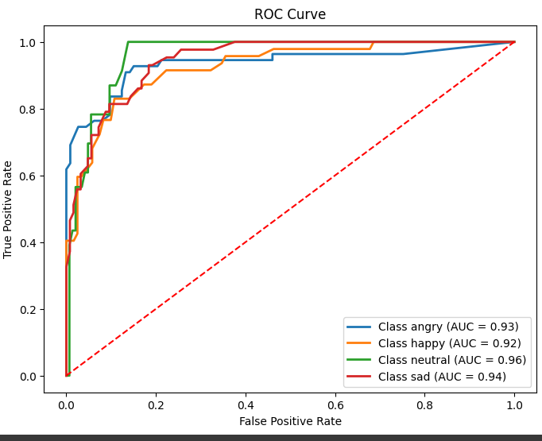
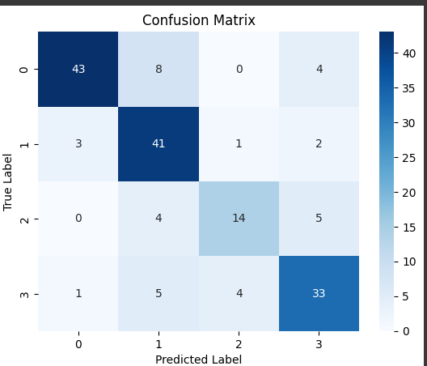

Slide 22
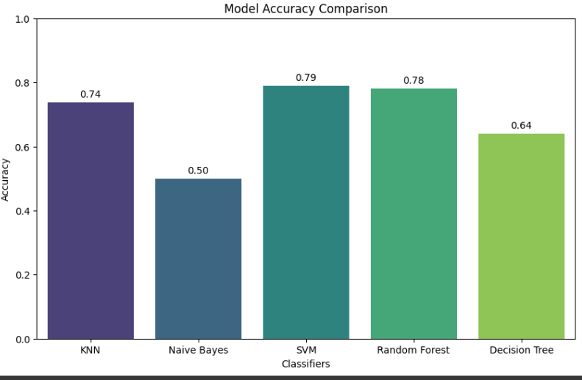

Slide 23
REASON
Overfitting or Underfitting:
If the model is too simple (underfitting) or too complex (overfitting), it fails to generalize well on unseen data.
Overfitting: Tree depth is too large, capturing noise instead of patterns.
Underfitting: Tree depth is too shallow, missing key relationships.
Class Imbalance
If one class dominates the dataset, the model may predict the majority class more often, ignoring the minority class..
Class Imbalance or Noise:
Noise, missing values, irrelevant features, or lack of meaningful input features can prevent the model from learning effectively.

Slide 24
DATASET 3: CREMA-D
The CREMA-D (Crowd-Sourced Emotional Multimodal Actors Dataset) is a comprehensive resource designed for the study of emotion recognition. It contains over 7,400 audio-visual clips of 91 actors performing a diverse set of 12 sentences in six basic emotional states: anger, disgust, fear, happiness, sadness, and neutral. Each clip is multimodal, featuring audio data, captured in high-definition. Actors in the dataset vary in age, ethnicity, and gender, providing a rich diversity for research. CREMA-D's unique feature is its crowd-sourced evaluation, where over 2,400 participants rated each clip on perceived emotion and intensity, ensuring robust ground truth labels.
Features:
MFCC (Mel-Frequency Cepstral Coefficients): Extracts features representing the short-term power spectrum of sound, capturing the tone of speech.
Chroma: Represents the 12 different pitch classes, capturing harmonic content and tonality in the audio signal.
Contrast: Captures the spectral contrast between peaks and valleys in the sound spectrum, helping to differentiate between emotions.

Slide 25
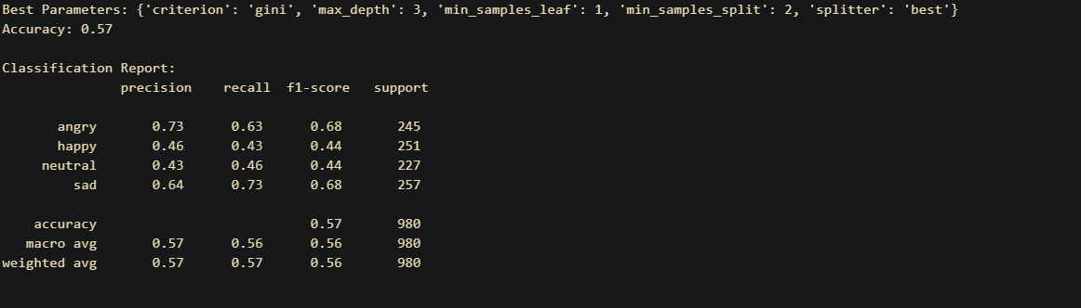
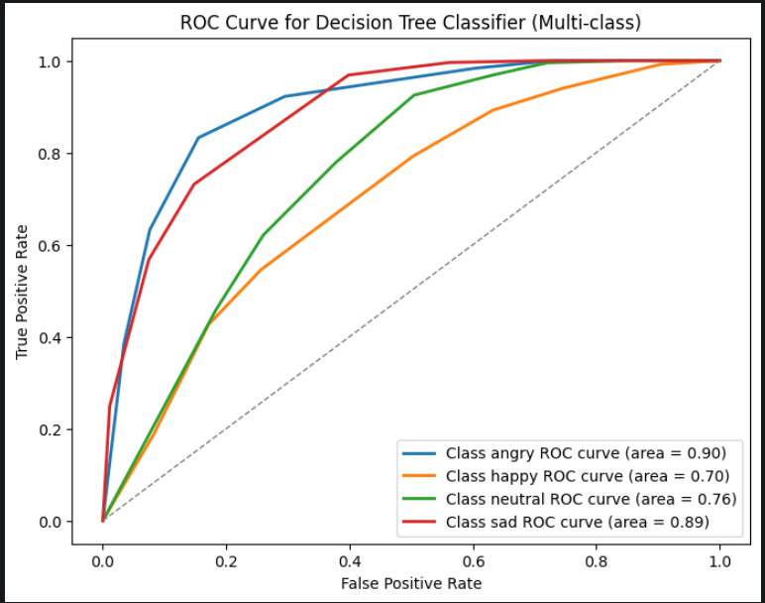
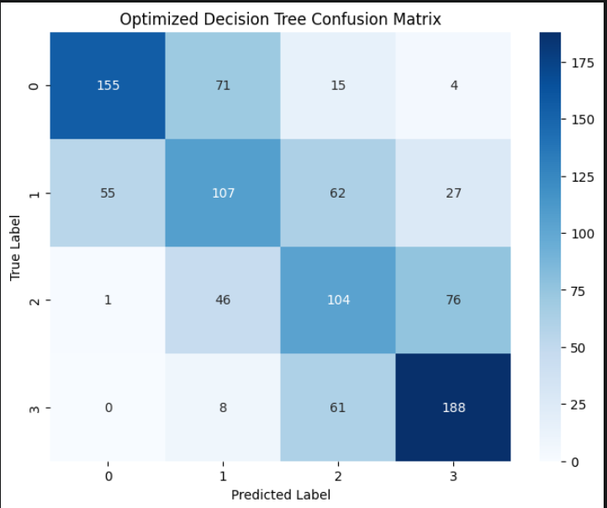
DECISION TREE

Slide 26
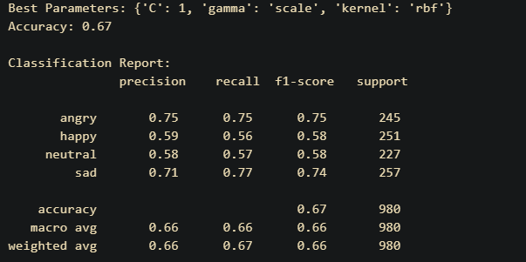
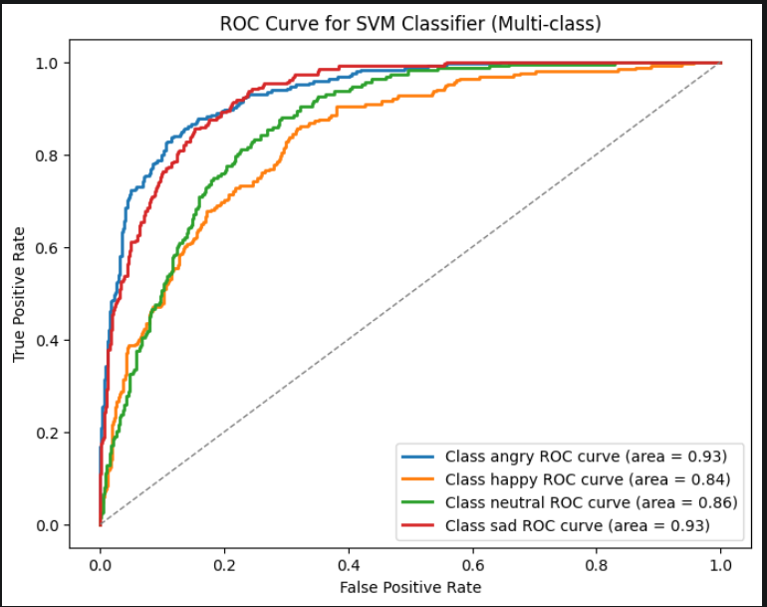
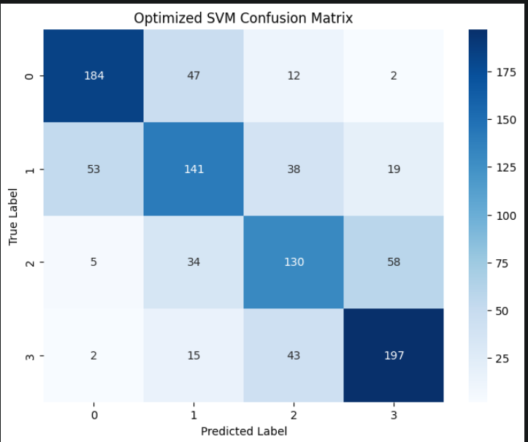
SUPPORT VECTOR MACHINES

Slide 27
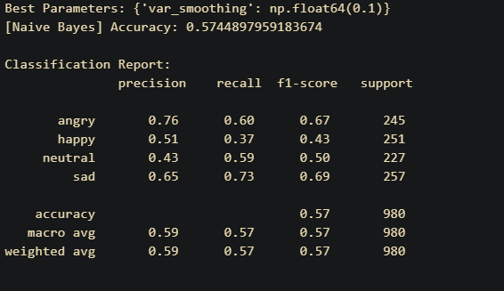
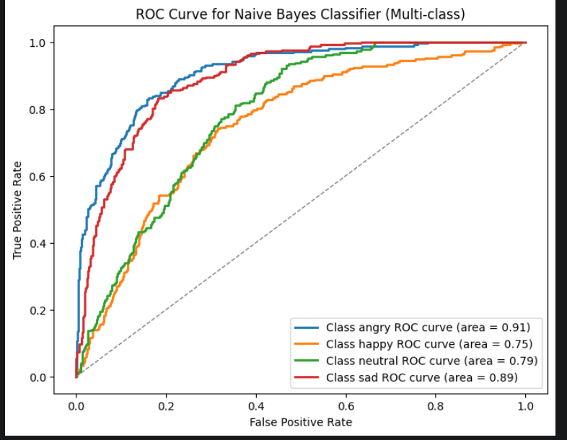
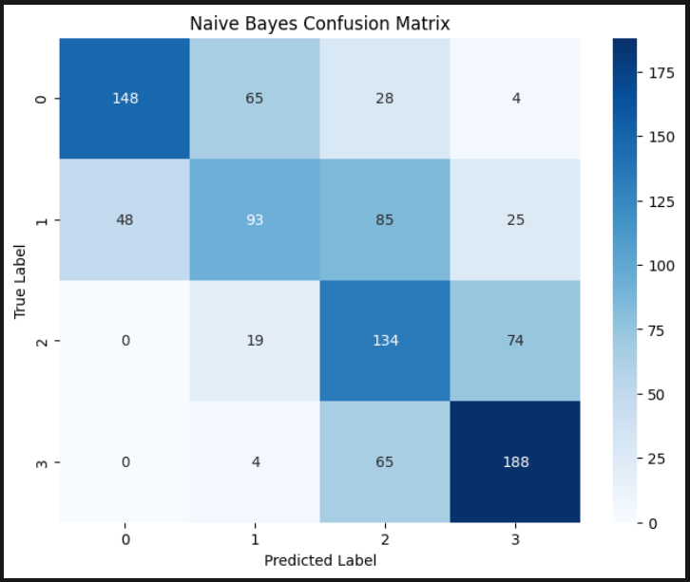
NAIVE BAYES

Slide 28
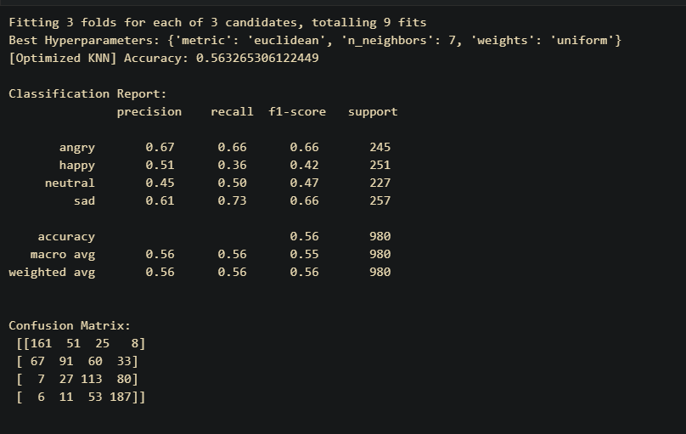
KNN

Slide 29
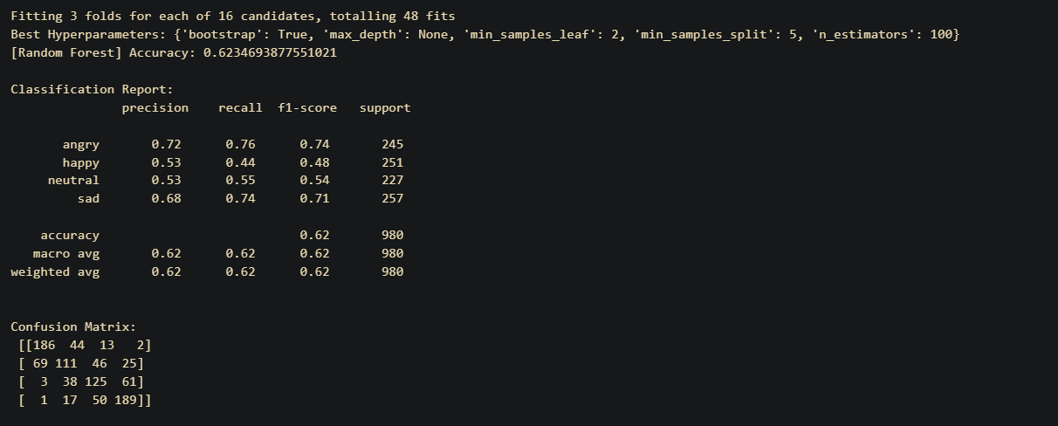
RANDOM FOREST

Slide 30
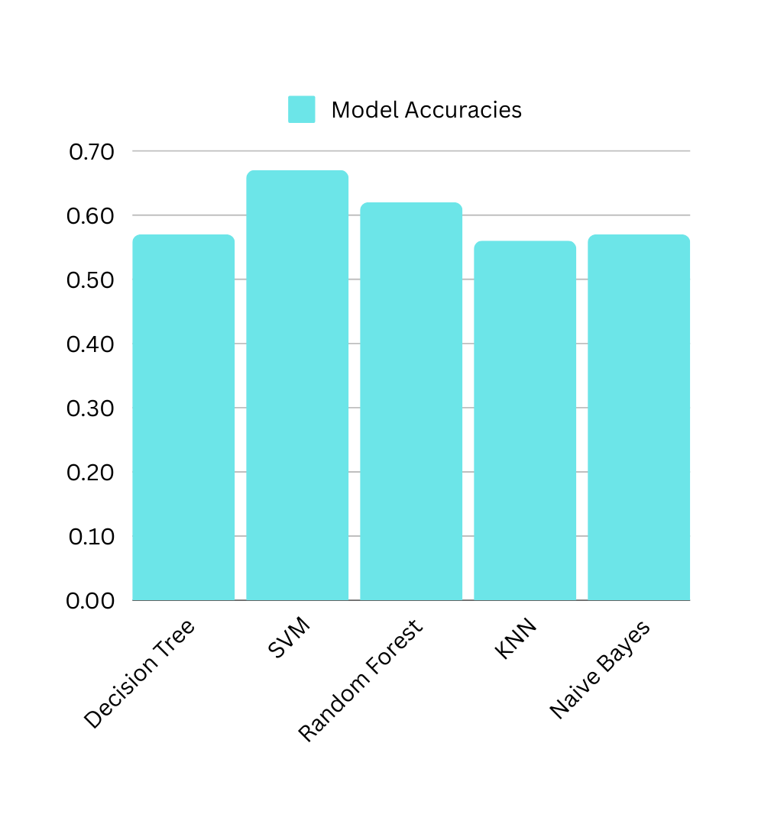

Slide 31
REASON
Overfitting :
If the model is too complex (overfitting), it fails to generalize well on unseen data.
Overfitting: Tree depth is too large, capturing noise instead of patterns.
Need of use of Deep Learning Techniques
Working with more than 7000 files with simple ML models couldn’t classify the proper differences between emotions like neutral and happy that are easy to get confused.
Only using 3 features:
Due to a few limitations, especially time, adding more features to the already big dataset was increasing the complexity of the program, hence running for a long time, hence we had to stick with 3 features with this dataset.

Slide 32
DATASET 4: SAVEE
The Savee dataset (SAVEE) is a collection of audio recordings used primarily for emotion recognition research. The dataset consists of emotional speech data collected from 4 male and 4 female speakers, each producing sentences with a variety of emotional tones.
Features
MFCC (Mel-Frequency Cepstral Coefficients): Extracts features representing the short-term power spectrum of sound, capturing the timbral texture of speech.
Chroma: Represents the 12 different pitch classes, capturing harmonic content and tonality in the audio signal.
MEL Spectrogram Frequency: A representation of the audio signal in terms of its frequency content, using the MEL scale to better match human hearing.

Slide 33
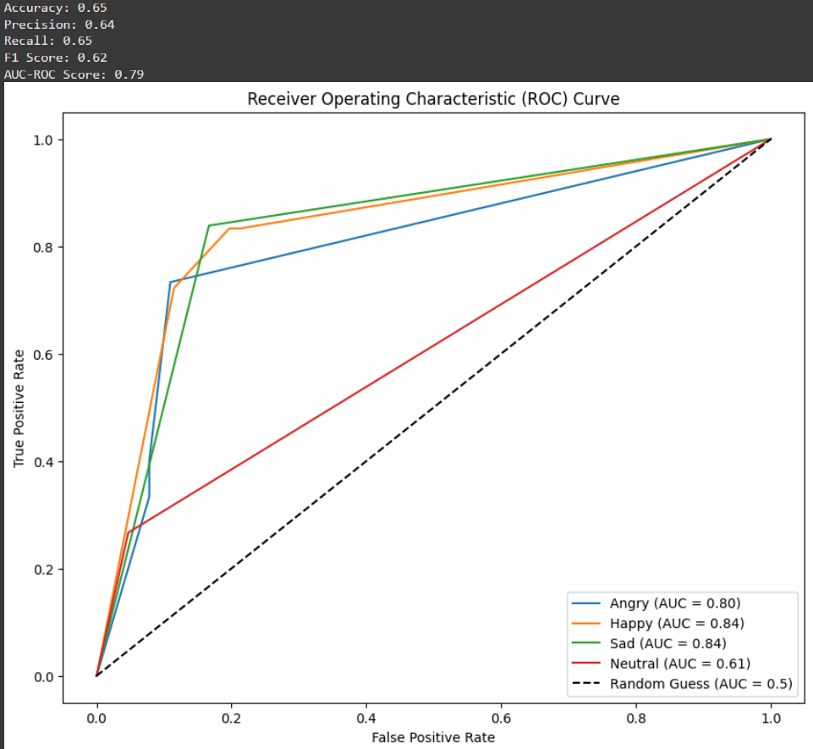
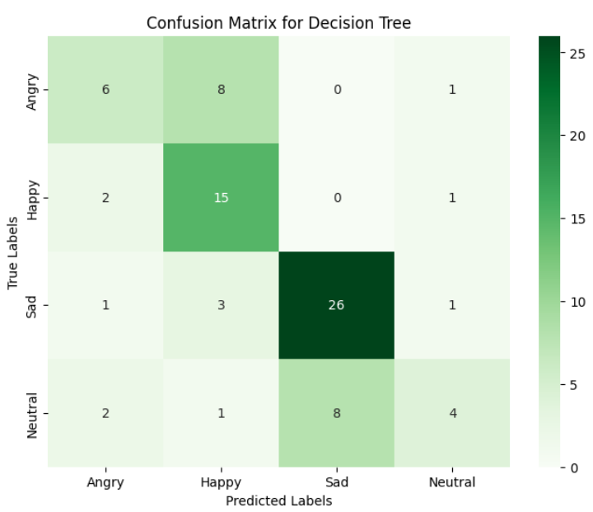
DECISION TREE

Slide 34
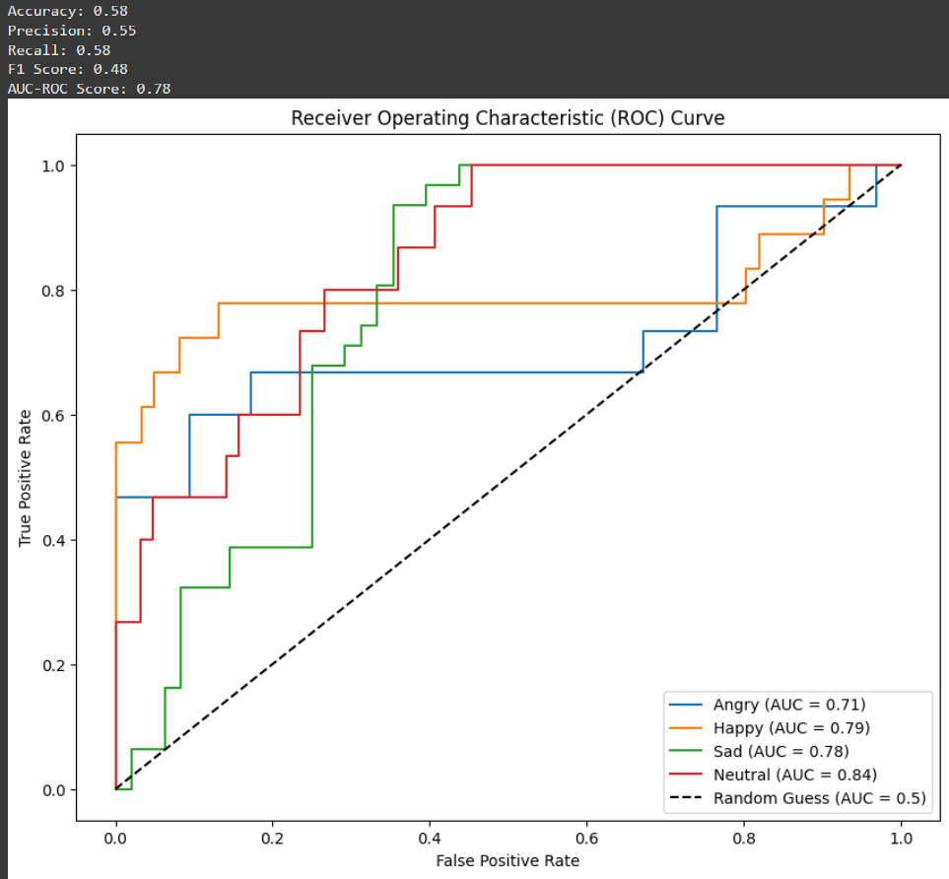
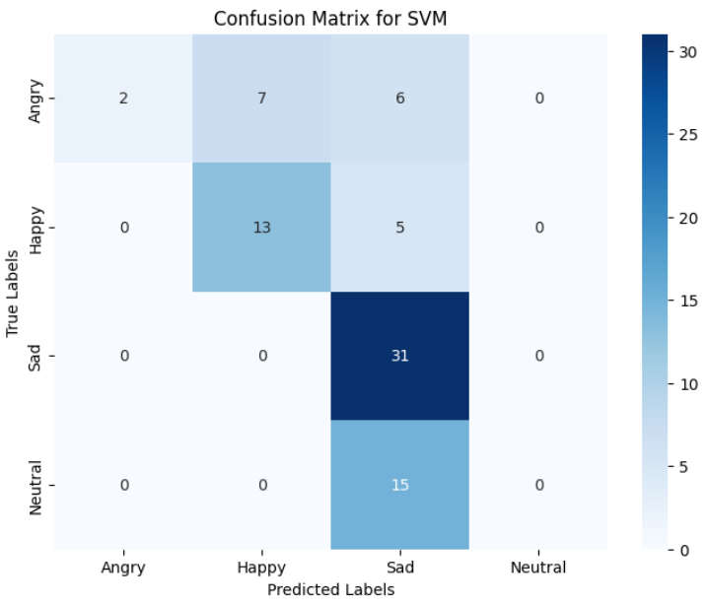
SUPPORT VECTOR MACHINES

Slide 35
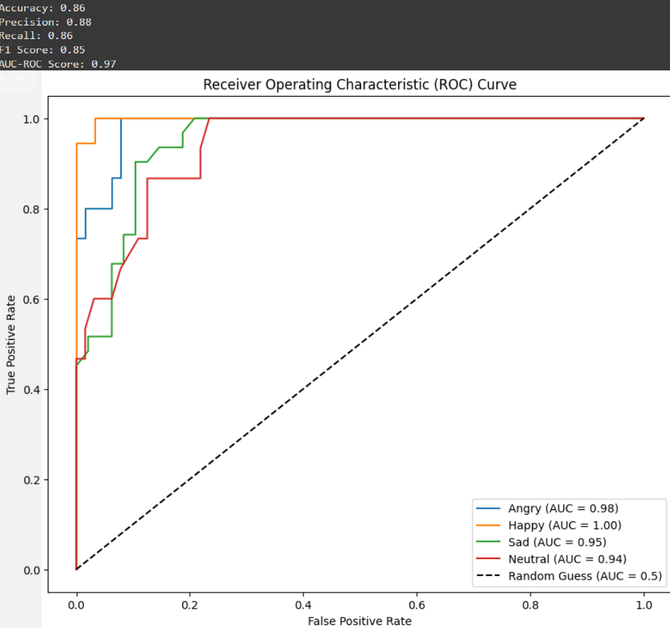
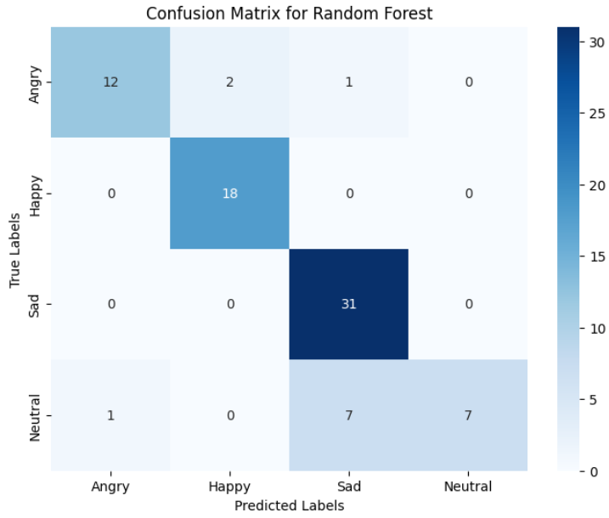
RANDOM FOREST

Slide 36
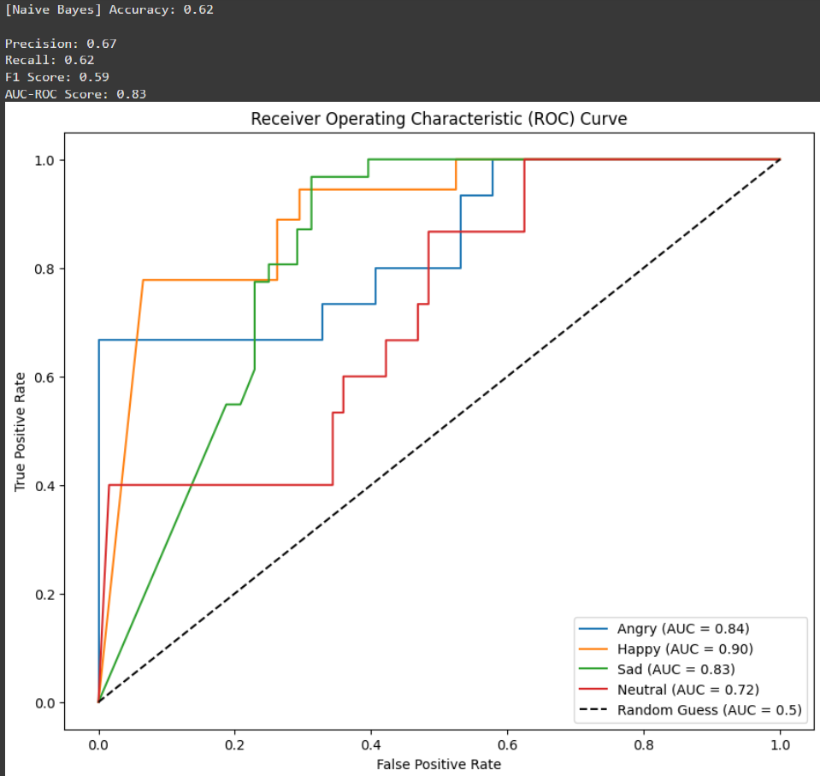
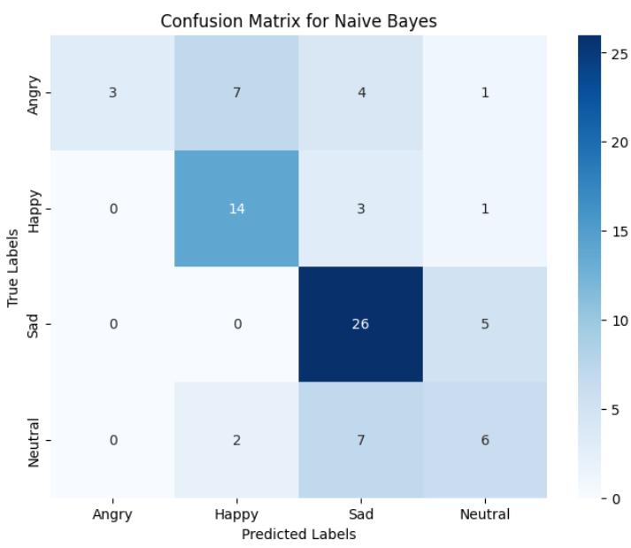
NAIVE BAYES

Slide 37
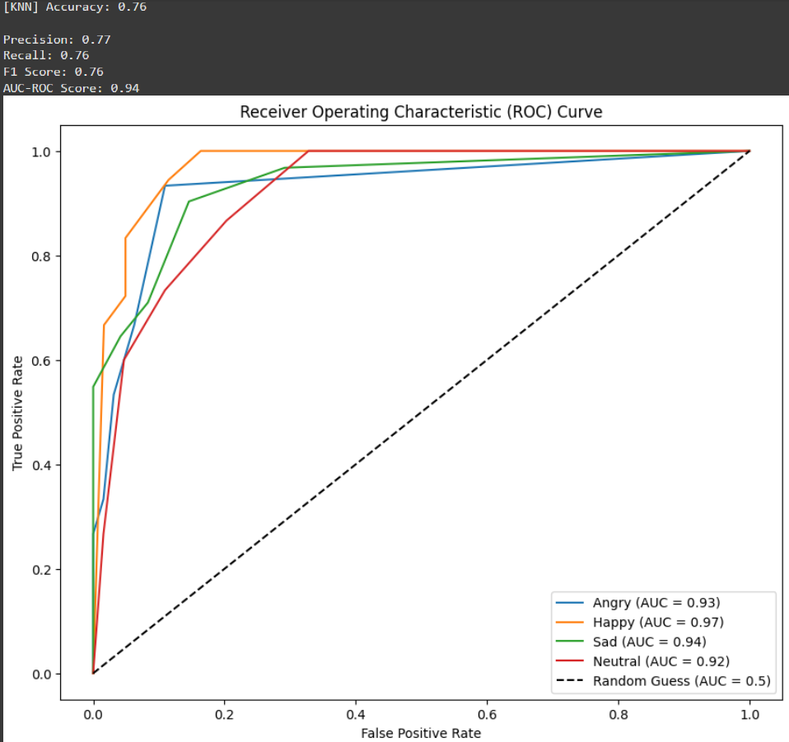
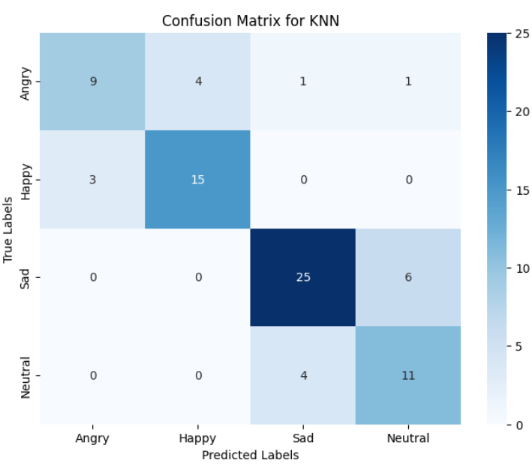
K NEAREST NEIGHBOURS

Slide 38
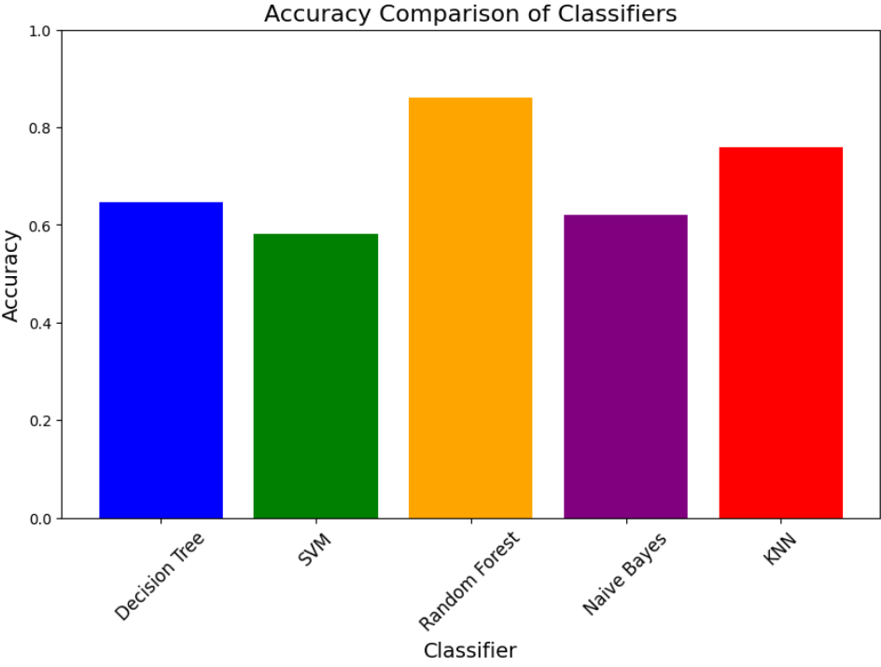
COMPARISON

Slide 39
REASON
Handles Complex and Non-Linear Data: Random Forest captures complex relationships between features (like pitch, energy, and MFCCs) better than simpler models.
Reduces Overfitting: By averaging predictions from multiple decision trees, Random Forest avoids overfitting, which is common in Decision Trees and SVMs.
Works Well with Limited Data: Random Forest performs reliably even on smaller datasets like SAVEe, while KNN and Naive Bayes struggle without large amounts of data.

Slide 40
CONCLUSION - BEST MODELS IN EACH DATASET
EMO-DB
RAVDNESS
SUPPORT VECTOR MACHINES
SUPPORT VECTOR MACHINES
CREMA-D
SAVEE
SUPPORT VECTOR MACHINES
RANDOM FOREST

